Slide 1

Predictive Analytics Lab
Submitted To: Dr. Achala Shakya
Submitted By:
 | SAP ID | Branch
Saurav Singh | 500111516 | CSE AIML(Hons.)
Mohit Kumar | 500107406 | CSE AIML(Hons.)

Slide 2
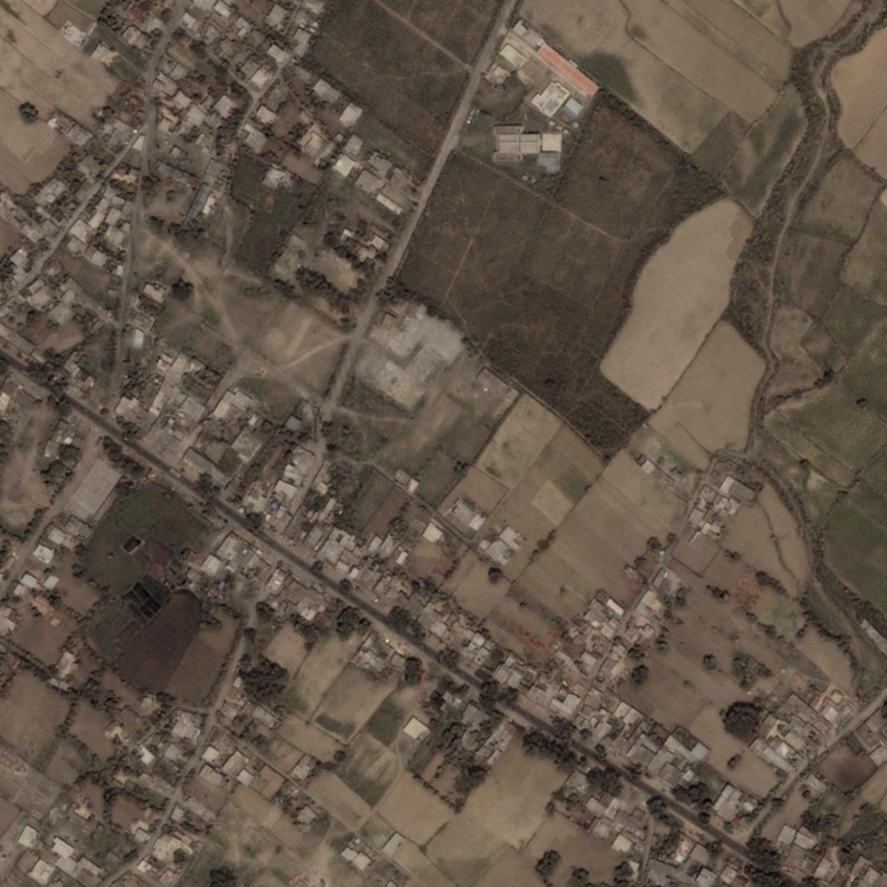
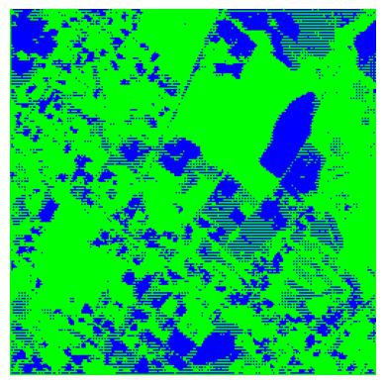
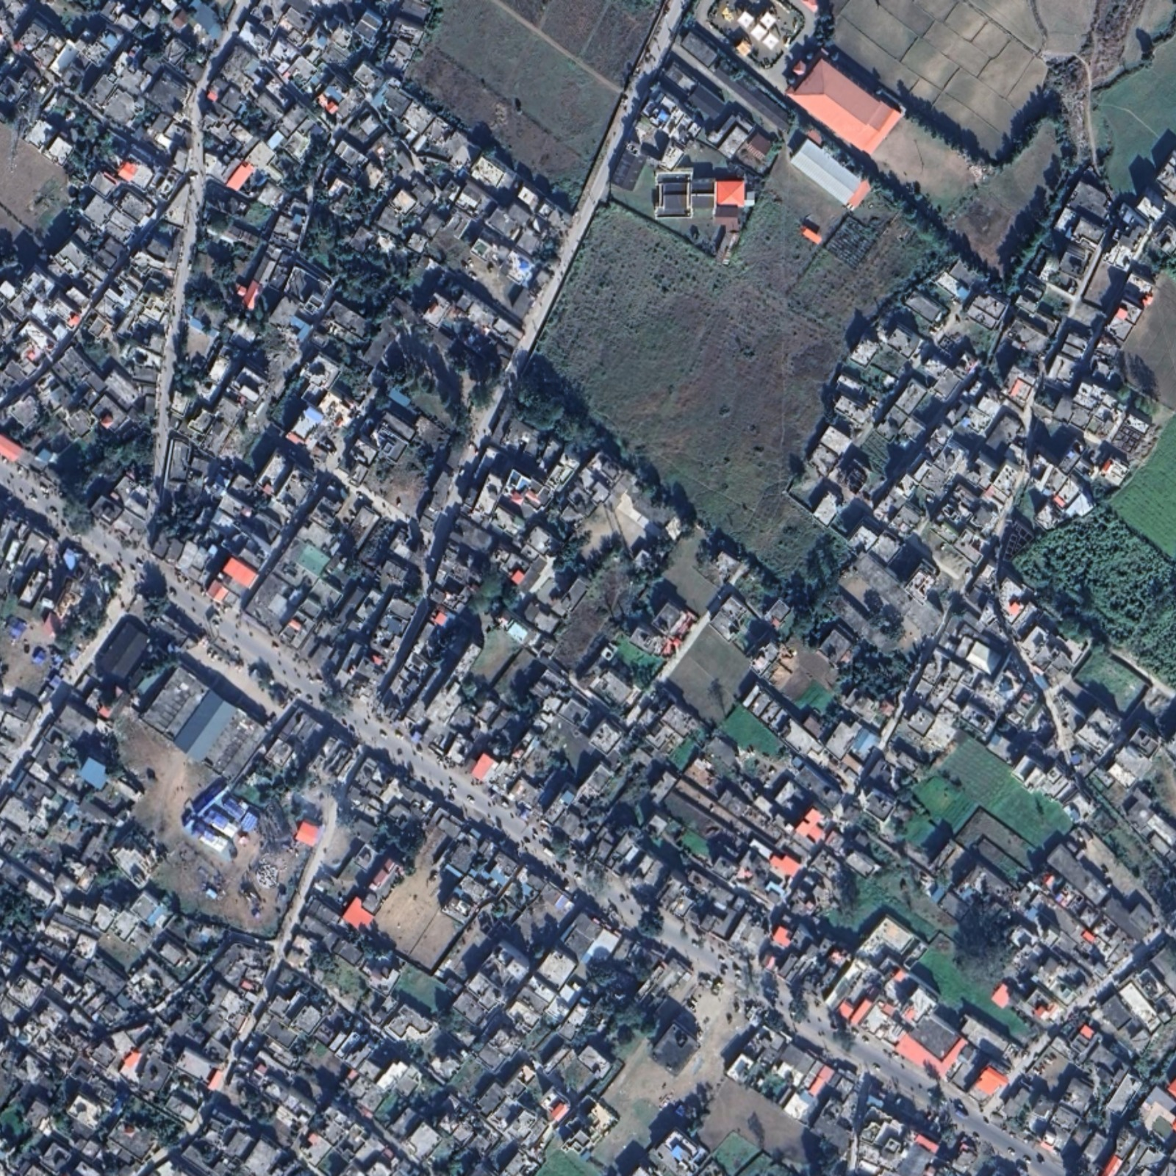
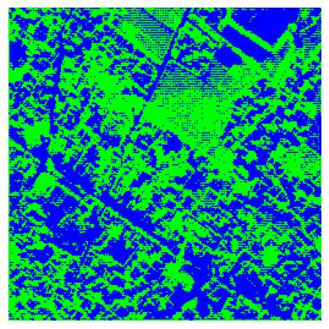
Project Title : Land Change Prediction

Slide 3
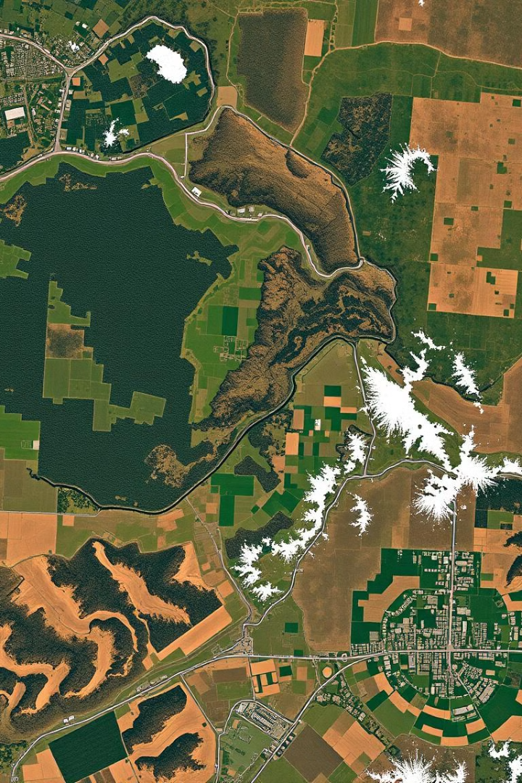
Land Change Prediction
Land change detection is a critical field in environmental monitoring and urban planning, enabling the identification and analysis of changes in land cover over time. Deep learning techniques, particularly the UNet model, are powerful tools for performing this task with high accuracy and efficiency.

Slide 4
2012
Introduction to Land Change Detection
1
Image Acquisition
Acquiring geospatial images of the same location at different points in time is the first step. These images can be obtained from various sources, including satellite imagery and aerial photography.
2024
2
Pre-processing
Pre-processing steps include geometric correction, radiometric calibration, and atmospheric correction, ensuring that images are aligned and comparable.
3
Change Detection Analysis
Change detection algorithms are employed to identify areas where significant differences exist between the two images, indicating changes in land cover.

Slide 5

Importance of Land Change Prediction
1
Environmental Monitoring
2
Urban Planning
Tracking deforestation, habitat loss, and pollution levels.
Identifying areas of rapid urbanization, guiding urban development strategies.
3
Disaster Management
4
Climate Change Studies
Assessing damage caused by natural disasters like floods, earthquakes, and wildfires.
Evaluating the impact of climate change on land cover patterns.

Slide 6
Challenges in Land Change Prediction
Data Noise and Variability
Spectral Similarity
Spatial Resolution
Variations in atmospheric conditions, sensor noise, and shadowing can affect the accuracy of change detection.
Certain land cover types, such as grasslands and croplands, can have similar spectral signatures, making it challenging to differentiate them.
Low-resolution imagery might not capture fine-grained changes, leading to inaccurate results.

Slide 7
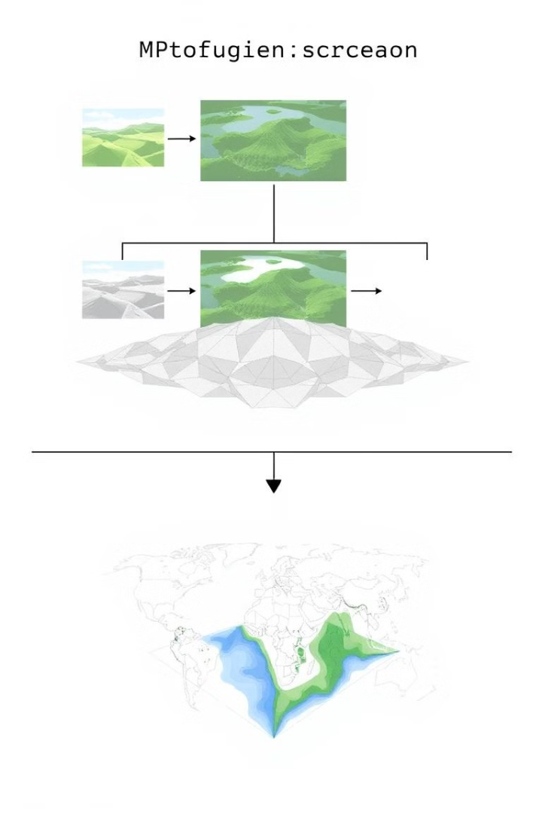



Overview of Deep Learning Techniques
Convolutional Neural Networks (CNNs)
CNNs are particularly well-suited for image processing tasks, extracting features from images and learning complex patterns.
Recurrent Neural Networks (RNNs)
RNNs are capable of processing sequential data, like time series, and capturing temporal dependencies in land cover changes.
Autoencoders
Autoencoders are unsupervised learning techniques that learn a compressed representation of input data, useful for anomaly detection in land cover changes.

Slide 8
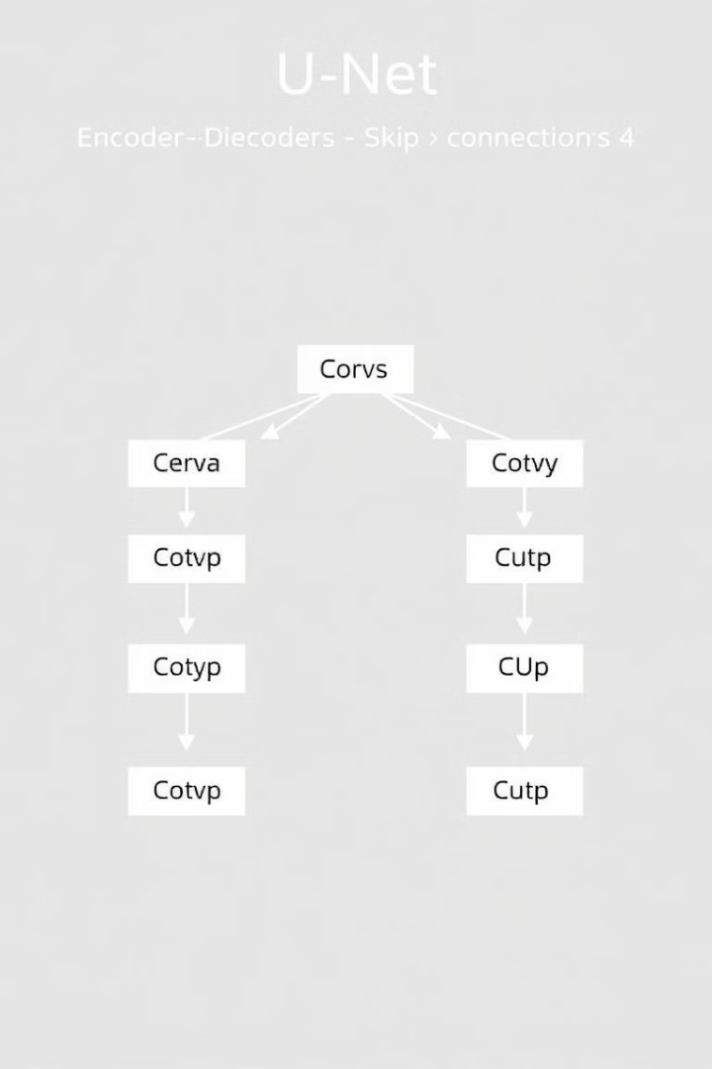
Introducing the UNet Model
Encoder-Decoder Structure
Skip Connections
Skip connections allow the network to propagate information from earlier layers to later layers, improving the accuracy and detail of the segmentation results.
The UNet architecture consists of an encoder that downsamples the input image to extract features and a decoder that upsamples the features to generate a segmentation map.
Pixel-Level Segmentation
The UNet model is designed for pixel-level segmentation, where each pixel in the image is classified into a specific land cover category.

Slide 9
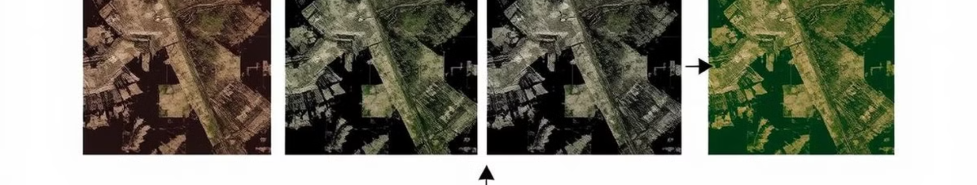
Training the UNet Model
Step 1
Data Preprocessing
Step 2
Data Augmentation
Step 3
Model Initialization
Step 4
Training with Backpropagation
Step 5
Model Evaluation and Validation

Slide 10
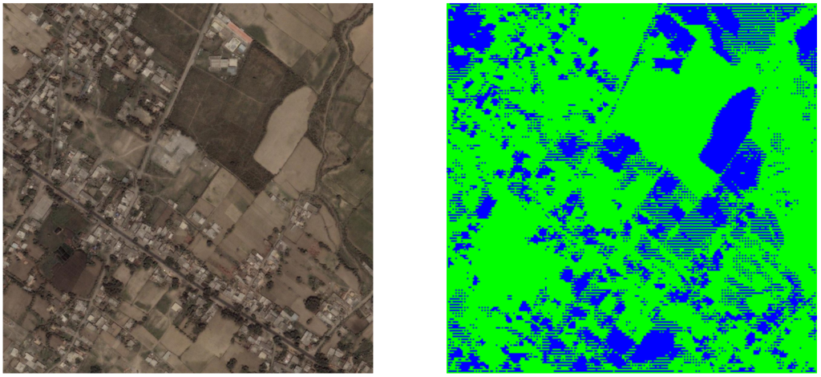
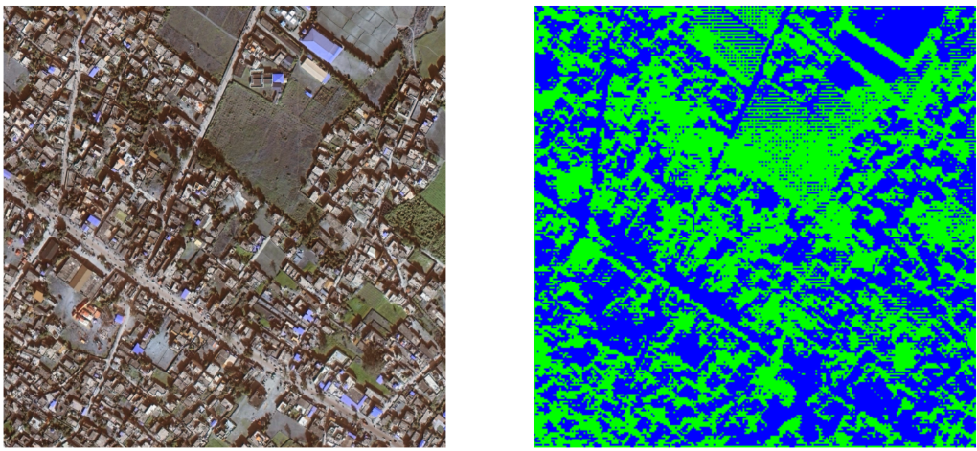
Using the model on two images like before and after of the same place
2012
2024

Slide 11
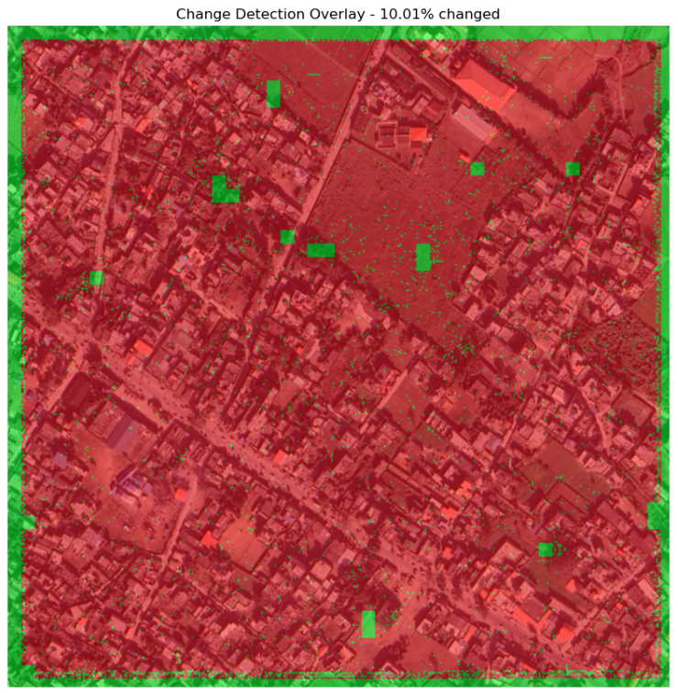
Red part is for better understanding of the change ouucured.
Green part represents the change occurred in the 2024 geospatial image.

